Slide 1
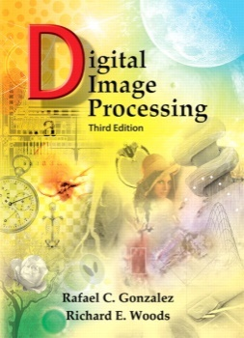
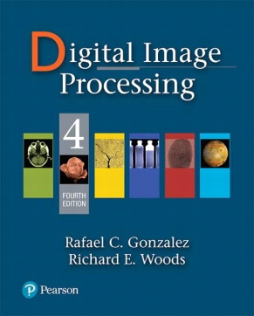
CSC 331: Digital Image Processing
Instructor Ms. Muntaha Iqbal (muntahaiqbal@cuilahore.edu.pk)
Text books and notes 1. R. C. Gonzalez and R. E. Woods, “Digital Image Processing”, 4th Edition, Pearson Education,
2. R. C. Gonzalez, R. E. Woods and S.L. Eddins, “Digital Image Processing using MATLAB” 2nd Edition, Pearson Education, Inc., 2004
3.Class Slides
Additional books Practical Image And Video Processing Using Matlab by OGE MARQUES

Slide 2
CSC 331: Digital Image Processing
Resources Google Classroom Page
Grading Policy

Slide 3
Course objectives
To give a thorough understanding of advance tools, algorithms and techniques used in image processing
To enable students to be able to solve an image processing problem and to design systems on their own
by giving them working experience on image processing tools
To introduce advanced topics in image processing and invoke interest for doing research in this field

Slide 4
Pre-requisites for the course
Basic Image Processing Knowledge, Knowledge of probability and random variables, linear algebra, vectors and matrices.
Working knowledge of MATLAB

Slide 5
Assignments
Assignments can be written assignments OR programming assignments.
The deadline for the submission of an assignment will be provided with the assignment.
Assignments submitted after the deadline will not be accepted and will carry ZERO MARKS.
Cheated assignments will get ZERO MARKS.
*
5
Notes:
5

Slide 6
Project
Projects will have ~? % weight in the total marks.
Projects may be conducted in groups of two-three students.
Project topics should be selected and got approved within the first three weeks of the course.
Project presentation date will be announced, and projects will not be accepted after the presentation date.
Projects consisting of downloaded codes or presentations will not be accepted and will carry ZERO MARKS.
*
6
Notes:
6

Slide 7
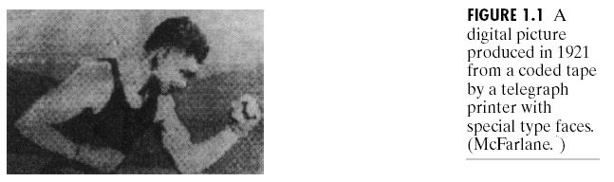
History
Early 1920s: One of the first applications of digital imaging was in the news- paper industry
The Bartlane cable picture transmission service
Images were transferred by submarine cable between London and New York
Pictures were coded for cable transfer and reconstructed at the receiving end on a telegraph printer
Early digital image

Slide 8
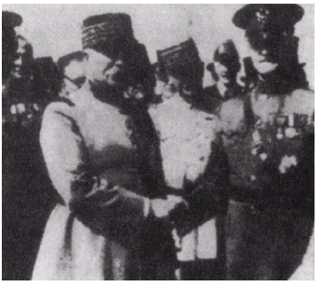
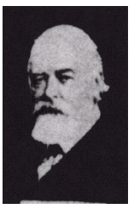
History
Mid to late 1920s: Improvements to the Bartlane system resulted in higher quality images
New reproduction processes based on photographic techniques
Increased number of tones in reproduced images
Improved digital image
Early 15 tone digital image

Slide 9
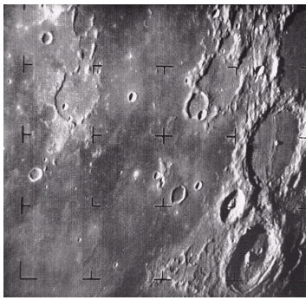
History
1960s: Improvements in computing technology and the onset of the space race led to a surge of work in digital image processing
1964: Computers used to improve the quality of images of the moon taken by the Ranger 7 probe
Such techniques were used in other space missions including the Apollo landings
A picture of the moon taken by the Ranger 7 probe minutes before landing

Slide 10
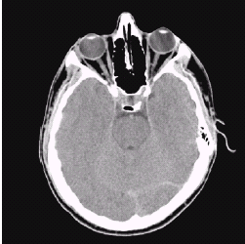
History
1970s: Digital image processing begins to be used in medical applications
1979: Sir Godfrey N. Hounsfield & Prof. Allan M. Cormack share the Nobel Prize in medicine for the invention of tomography, the technology behind Computerised Axial Tomography (CAT) scans
Typical head slice CAT image

Slide 11
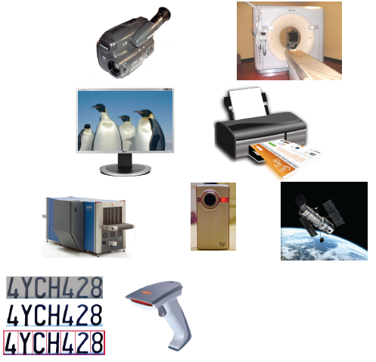
Why do we process images?
Image from : Bernd Girod, © 2013-2014 Stanford University
*
COMSATS University Islamabad, Lahore Campus -- Digital Image Processing -- CSC331
11
Notes:
11

Slide 12
Why do we process images?
Facilitate picture storage and transmission
Efficiently store an image in a digital camera
Send an image through mobile phone
Enhance and restore images
Remove scratches from an old photo
Improve visibility of tumor in a radiograph
Extract information from images
Measure water pollution from aerial images
Measure the 3D distances and heights of objects from stereo images
Prepare for display or printing
Adjust image size
Halftoning
Biometrics based identification
*
COMSATS University Islamabad, Lahore Campus -- Digital Image Processing -- CSC331
12
Notes:
12

Slide 13

History
1980s - Today: The use of digital image processing techniques has exploded and they are now used for all kinds of tasks in all kinds of areas
Image enhancement/restoration
Artistic effects
Medical visualisation
Industrial inspection
Law enforcement
Human computer interfaces

Slide 14
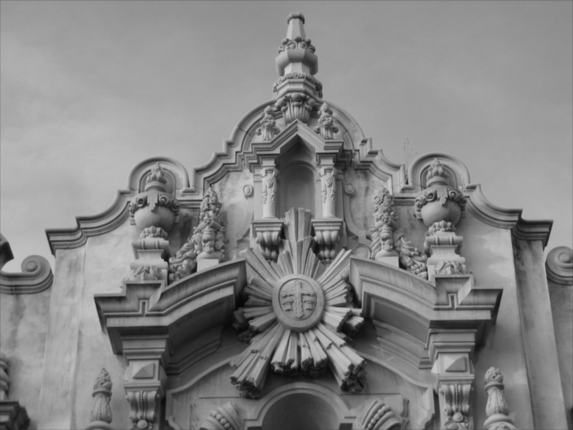

Image Processing Examples
Photo Sharpening

Slide 15
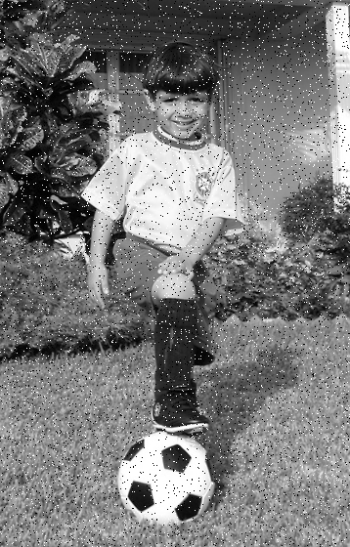

Image Processing Examples
Noise Removal

Slide 16
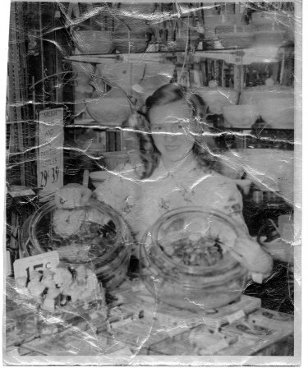
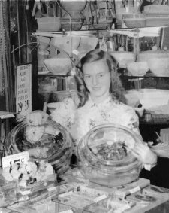
Image Processing Examples
Photo restoration
Damaged Image Restored Image

Slide 17
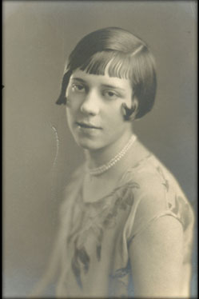
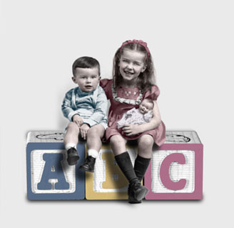
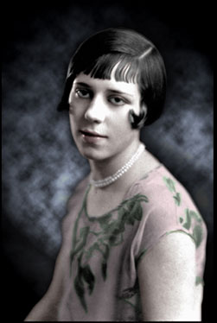
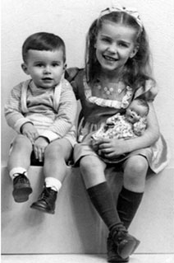
Image Processing Examples
Photo colorization
Original B/W Image colorized Image Original Image Colorized Image

Slide 18
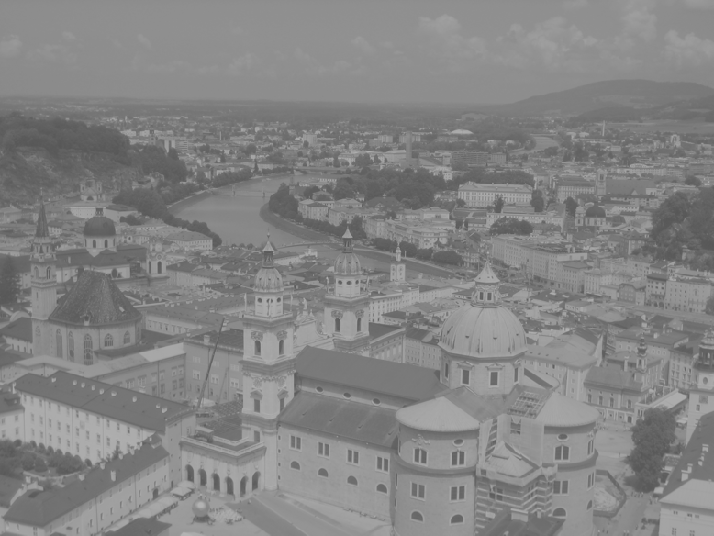
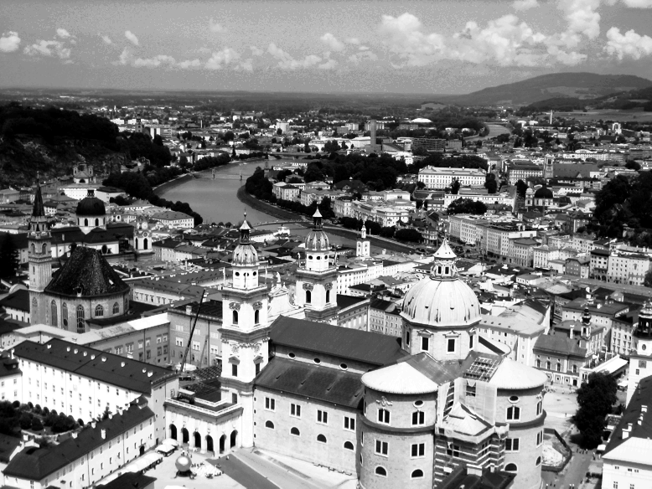
Image Processing Examples
Contrast enhancement
Original Image Enhanced Image

Slide 19
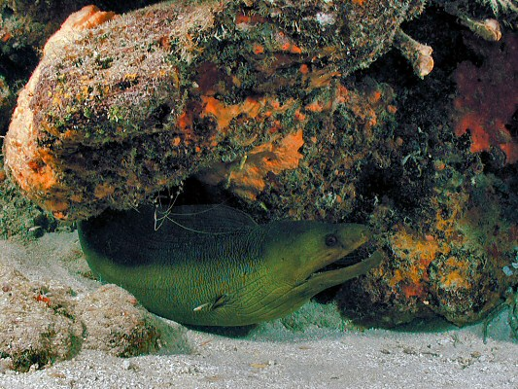
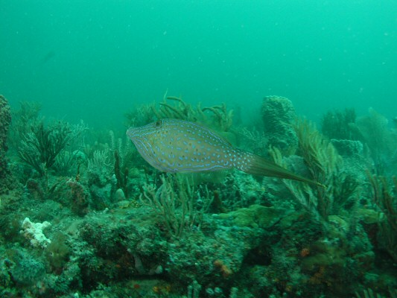
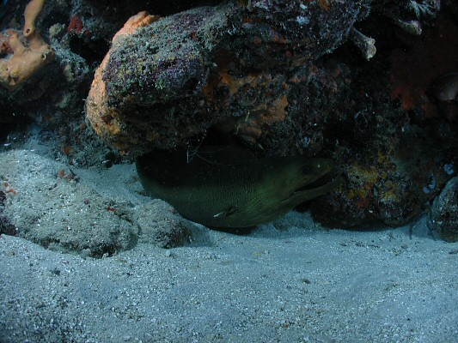
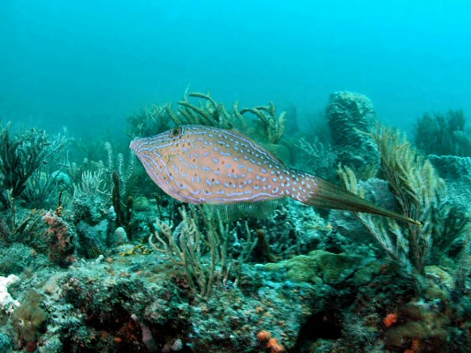
Image Processing Examples
Color photo enhancement
Original Images Enhanced Images

Slide 20
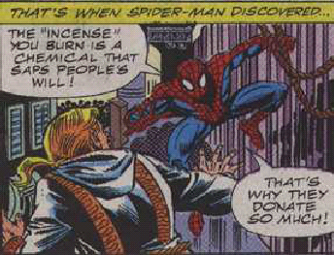
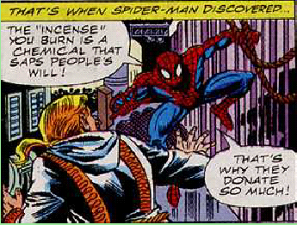
Image Enhancement
Initial image Final image
Performed steps: Gaussian blur, contrast enhancement, median filter and sharpening. Processing done by Photoshop.
Example taken from microscopy.berkeley.edu/courses/dib

Slide 21
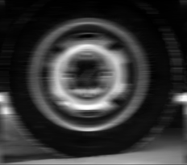
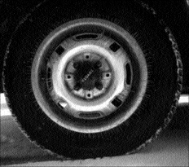
Image Processing Examples
Deblurring

Slide 22
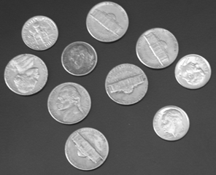

Image Processing Examples
Blurring

Slide 23
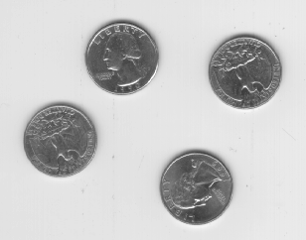

Image Processing Examples
Binarization

Slide 24
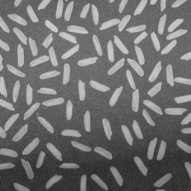

Image Processing Examples
Edge Extraction

Slide 25
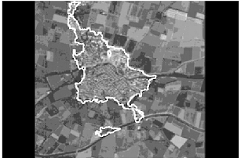
Image Processing Examples
Extraction of settlement area from an aerial image

Slide 26
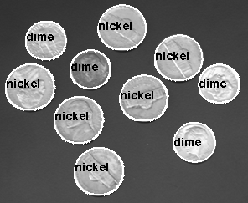
Image Processing Examples
Object Segmentation and Labeling

Slide 27
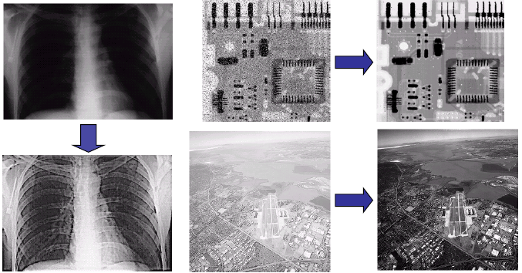
Image Processing Examples
Improving Quality

Slide 28
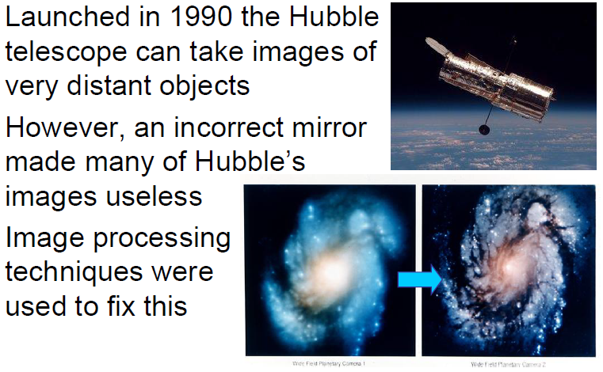
Image Processing Examples
Improving Quality

Slide 29
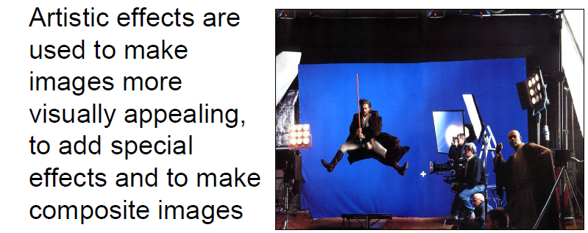
Image Processing Examples
Artistic Effects

Slide 30
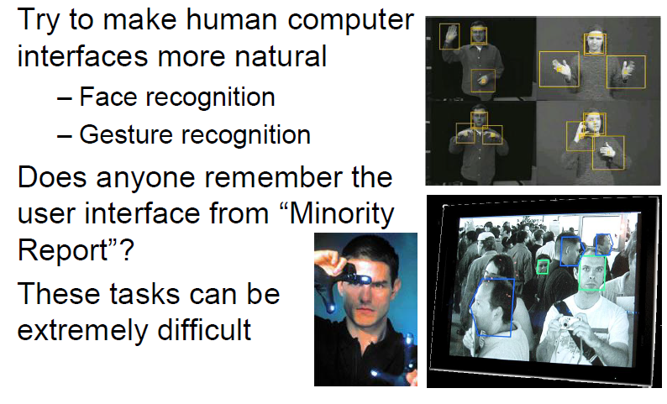
Image Processing Examples
HCI

Slide 31
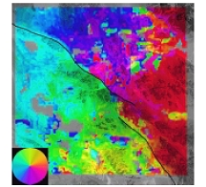
Image Processing Examples
Earthquake analysis from space
Image shows the ground displacement of a typical area due to earthquake

Slide 32
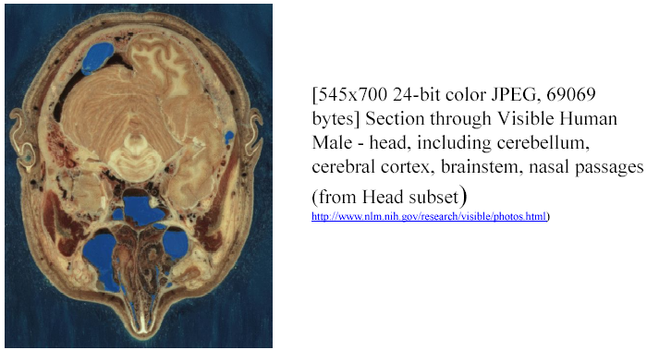
Image Processing Examples
Medical Imaging: Computer Aided Tomography (CAT)

Slide 33
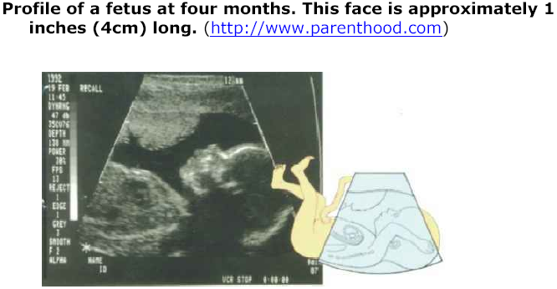
Image Processing Examples
Medical Imaging: Ultrasound imaging

Slide 34
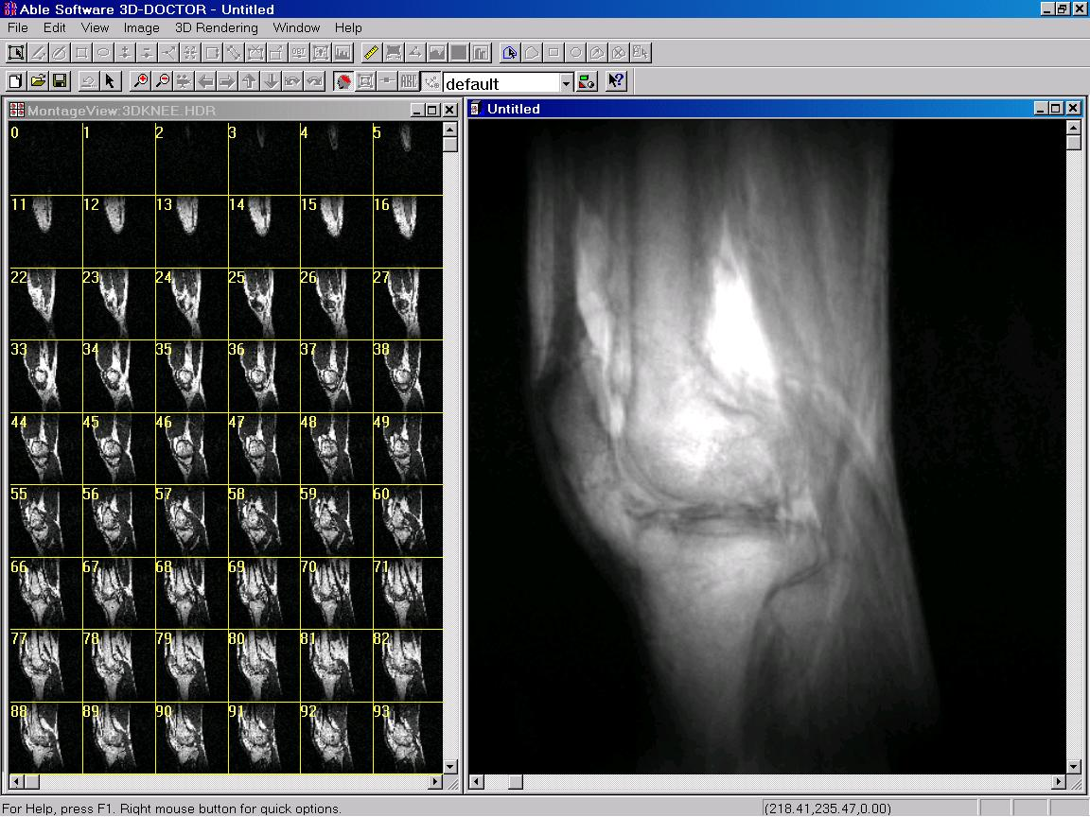
Image Processing Examples
Medical imaging: Averaging MRI slices for knee image

Slide 35


Image Processing Examples
Image compression
Original
JPEG 27:1

Slide 36
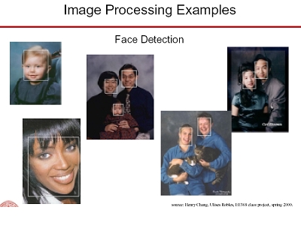
Image Processing Examples
Face detection

Slide 37
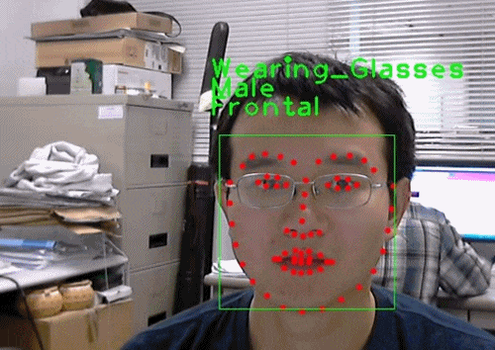
Image Processing Examples
Face Tracking

Slide 38
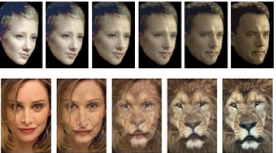
Image Processing Examples
Face Morphing

Slide 39
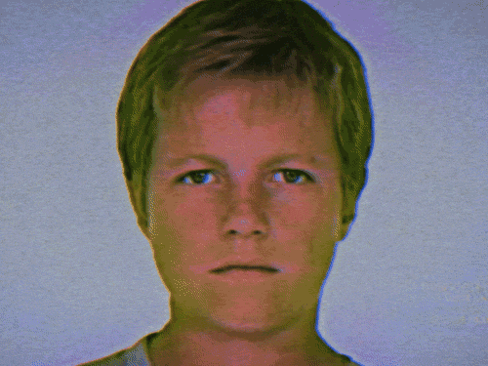
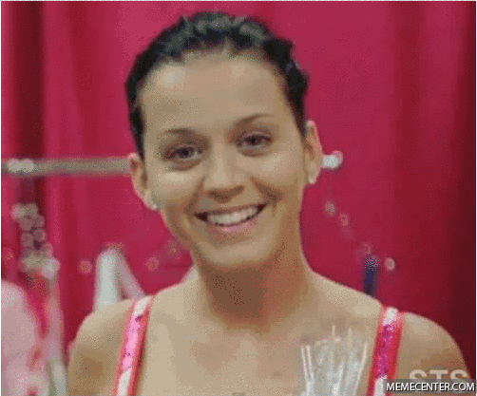
Image Processing Examples
Face Morphing

Slide 40
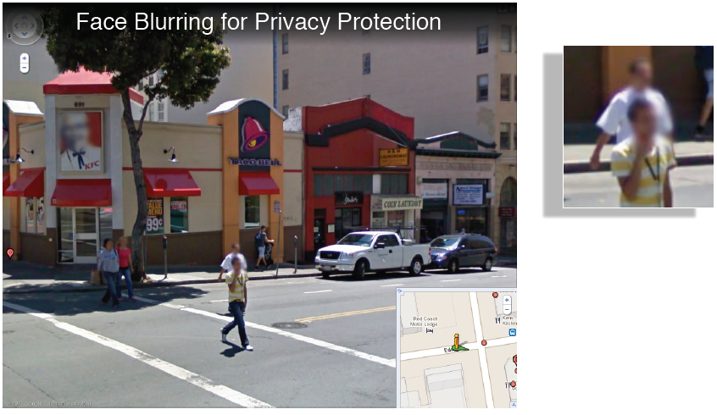
Image Processing Examples

Slide 41
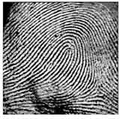
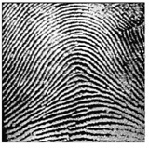
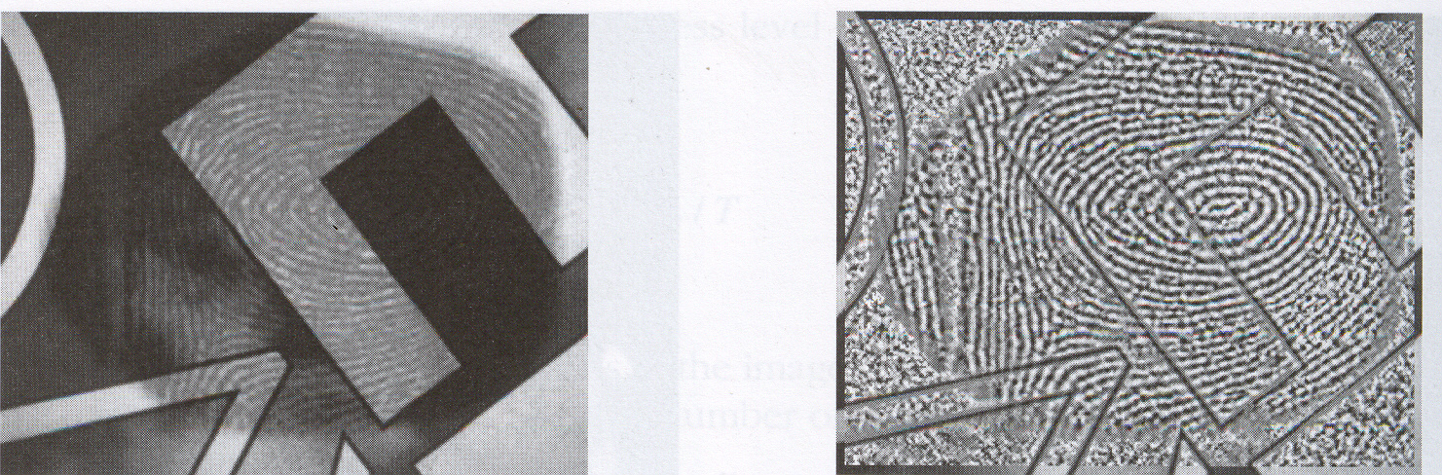
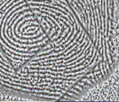
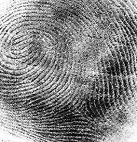
Image Processing Examples
Fingerprint recognition
X
X
√

Slide 42


Personal Identification using Iris Recognition
National Geographics: “Afghan Girl”
1983
2000

Slide 43


Removing geometric distortions of camera

Slide 44

Image Processing Examples

Slide 45

Computer Imaging Systems

